Slide 1

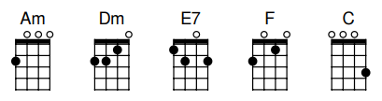

Wayfaring Stranger
Traditional, early 19th century
Robert Earl Keen, 2015
Chords in this song:
Strum for this song:
Revised July 5, 2026

Slide 2
Intro
[HOLD]
Next:
Am
I’m a poor wayfaring …

Slide 3

Verse 1 (1 of 2)
I’m a poor wayfaring stranger,
travelin’ thru this world of woe.
Next:
Am
There’s is no sickness …

Slide 4
Verse 1 (2 of 2)
There’s is no sickness, toil, or danger
in that bright world to which I go
Next:
F
I’m going there …

Slide 5
Chorus 1 (1 of 2)
I’m going there to see my father
I’m going the--re no more to roam
[HOLD]
Next:
Am
I’m only going over …

Slide 6
Chorus 1 (2 of 2)
I’m only going over Jordan
I’m only going over home
[HOLD]
Next: Interlude
Am Am …

Slide 7
Interlude
[HOLD]
Next:
Am
I know dark clouds …

Slide 8
Verse 2 (1 of 2)
I know dark clouds gonna gather ’round me,
I know my way is rough and steep
Next:
Am
Yet beauteous fields …

Slide 9
Verse 2 (2 of 2)
Yet beauteous fields lie just before me,
where God’s redeem-ed, their vigils keep.
Next:
F
I’m going there …

Slide 10
Chorus 2 (1 of 2)
I’m going there to see my mother
She said she’d me--et me when I come
[HOLD]
Next:
Am
I’m only going over …

Slide 11
Chorus 2 (2 of 2)
I’m only going over Jordan
I’m only going over home
[HOLD]
Next:
Am
I’m only going over …

Slide 12
Ending (1 of 2)
I’m only going over Jordan
I’m only going over home
[HOLD]
Next:
Am
I’m only going over …

Slide 13
Ending (2 of 2)
[NO STRUM – a cappella]
I’m only going over Jordan
I’m only going over home
Thanks y’all!!!

Slide 14
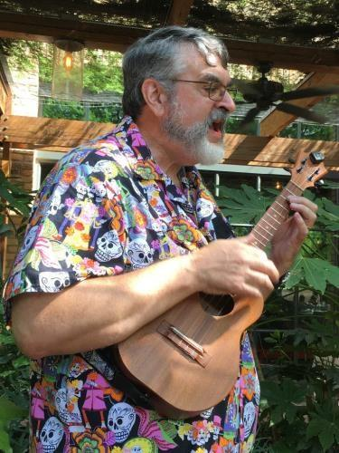
In memory of Kevin Jolly -- founder and inspiration of Tuesday Ukes

